Slide 1


MARKETING SUPPORT
SYSTEM
BIGDATA RAMPUP TEAM 2
JUNE 8, 2016

Slide 2
DOMAIN AND PROBLEM STATEMENT
DOMAIN
Advertising and marketing
Effectiveness of marketing companies
Provide near real time reporting as well as detailed analyses of enriched historical data to help business make better decisions.
PROBLEM
SOLUTION

Slide 3
REQUIREMENTS
FUNCTIONAL
Near real time behavior stream analysis
Complex reporting on historical data
Social network integration
Backup storage
Horizontal scalability
NRT latency – X seconds
High availability
Fault tolerance
Maintenability
NON FUNCTIONAL

Slide 4
ARCHITECTURE
SOLUTION COMPONENTS

Slide 5
ARCHITECTURE
DATA FLOWS

Slide 6
ARCHITECTURE
PACKAGES

Slide 7
ARCHITECTURE
DEPLOYMENT

Slide 8
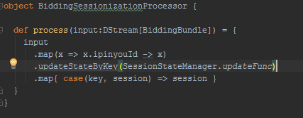
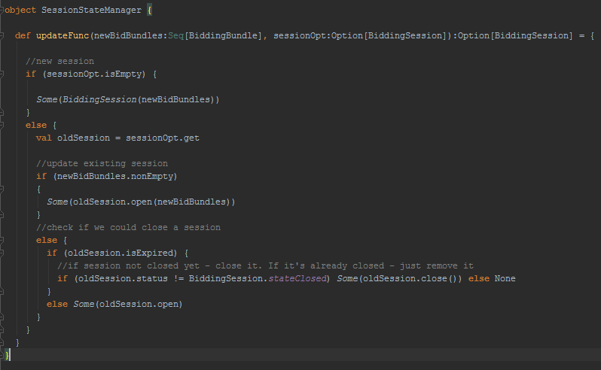
DEV HIGHLIGHTS
STREAM SESSIONIZATION
Pros
Performance
No additional infrastructure
Cons
Artefacts on Start / stop
Data model changes

Slide 9
DEV HIGHLIGHTS
CASSANDRA
Driver
Mapping is well-implemented by default, has extension points.
Datastax Cassandra-Spark driver requires guava library shading to work on YARN
Primary keys
Bidding bundle: partition key - (date, ipinyou_id), clustering key – (ts, bid_id)
Bidding sessions: partition key – (date, ipinyou_id), clustering key – session_start
Driver
Default mapping doesn’t work with some types (decimals, nested arrays).
Indexing
Tricky daily indices implementation
ELASTICSEARCH

Slide 10
ML HIGHLIGHTS
CHOOSING ALGORITHM
The task is to implement ML classification (supervised learning) for 2 binary classes (Yes/No). As of today out of the box MLLib supports 6 classification algorithms:
Linear Support Vector Machines
Logistic regression
Decision Trees
Random Forests
Gradient-Boosted Trees
Naive Bayes
All models where evaluated for all 156 features and following metrics are obtained :
(see next slide)

Slide 11
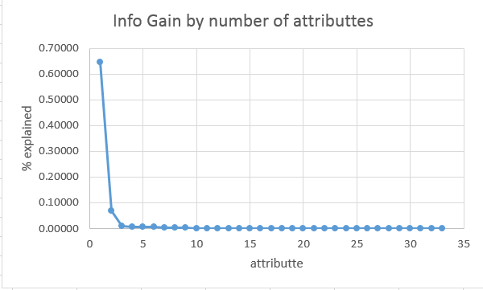
ML HIGHLIGHTS
FEATURE ENGINEERING
As much features as we could get/engineer was used for initial modelling (totally 156), including : timing info (time of day, weekday, session duration etc), ad metrics, geographical and demographics, keyword categories, count of stream ids).
Predicting ‘site-paid’ run into following difficulties – not only data is extremely unbalanced (0.0002 % of sessions), but it is extremely rare, not too many sessions, so ‘site-search’ was chosen as predicted variable.
To cope with imbalanced data(1:1100 or 0.089%) – under-sampling technique was used during modelling (https://en.wikipedia.org/wiki/Oversampling_and_undersampling_in_data_analysis)
Weka application was used to find attribute significance (attribute info gain) :
Ranked attributes:
0.647008 21 site_impression_count
0.0680094 28 bid_counters_size
0.0090796 12 city_id
0.0072033 29 ad_slots_size
0.0069651 31 keyword_counters_size
0.0065519 30 keyword_category_counters_size
0.0027738 35 category_4_count
0.0027729 69 category_38_count
Pearson correlation coefficient between site_impression_count and site_search is only -0.15492

Slide 12
ML HIGHLIGHTS
Model Metrics (without site_impression_count attribute)
---------------- DecisionTree ----------------
Area under ROC = 0.5672995552249682
Precision = 0.9791904490296796
ConfusionMatrix:
1222535.0 17404.0
8609.0 1503.0
---------------- Logistic Regression ----------------
Area under ROC = 0.5659713087783228
Precision = 0.9817119461525969
ConfusionMatrix:
1225740.0 14199.0
8662.0 1450.0
------ Linear Support Vector Machines (SVMs) ----------
Area under ROC = 0.4999931448240599
Precision = 0.9918971305970716
ConfusionMatrix:
1239922.0 17.0
10112.0 0.0
--------- Naive Bayes (multinomial) ----------------
Area under ROC = 0.5009335376712999
Precision = 0.8912164383693145
ConfusionMatrix:
1113012.0 126927.0
9058.0 1054.0
---------- Gradient Boosted Trees ----------------
Area under ROC = 0.5708963546297771
Precision = 0.9644350510499171
ConfusionMatrix:
1203865.0 36074.0
8384.0 1728.0
As could be seen from metrics above – Naïve Bayes and Linear SVM are not performing well with provided data, but results of other 3 models are comparable. We chose ‘Logistic Regression’ as it is less picky and doesn’t require categorical features specifications (easier to maintain), while providing results of comparable quality.

Slide 13
ML HIGHLIGHTS
Model Metrics (with site_impression_count attribute)
-------- DecisionTree --------------------------
Area under ROC = 0.9998135256091496
Precision = 0.9997527608373167
ConfusionMatrix:
8041.0 3.0
0.0 4090.0
------ Logistic Regression --------------------------
Area under ROC = 0.9988355304991252
Precision = 0.9990934564034943
ConfusionMatrix:
8041.0 3.0
8.0 4082.0
------ Linear Support Vector Machines (SVMs) ----------
Area under ROC = 0.5
Precision = 0.6629306082083402
ConfusionMatrix:
8044.0 0.0
4090.0 0.0
--------- Naive Bayes (multinomial) ----------------
Area under ROC = 0.503658241529777
Precision = 0.3870941157079281
ConfusionMatrix:
1174.0 6870.0
567.0 3523.0
---------- Gradient Boosted Trees ----------------
Area under ROC = 0.9998135256091496
Precision = 0.9997527608373167
ConfusionMatrix:
8041.0 3.0
0.0 4090.0
As could be seen from metrics above – Naïve Bayes and Linear SVM are not performing well with provided data, but results of other 3 models are comparable. We chose ‘Logistic Regression’ as it is less picky and doesn’t require categorical features specifications (easier to maintain), while providing results of comparable quality.

Slide 14

LIVE DEMO

Slide 15
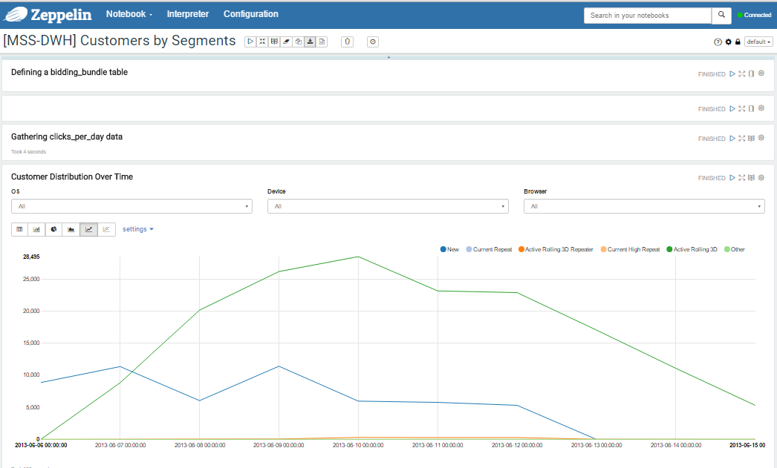
ZEPPELIN
DWH – CUSTOMERS BY SEGMENTS

Slide 16
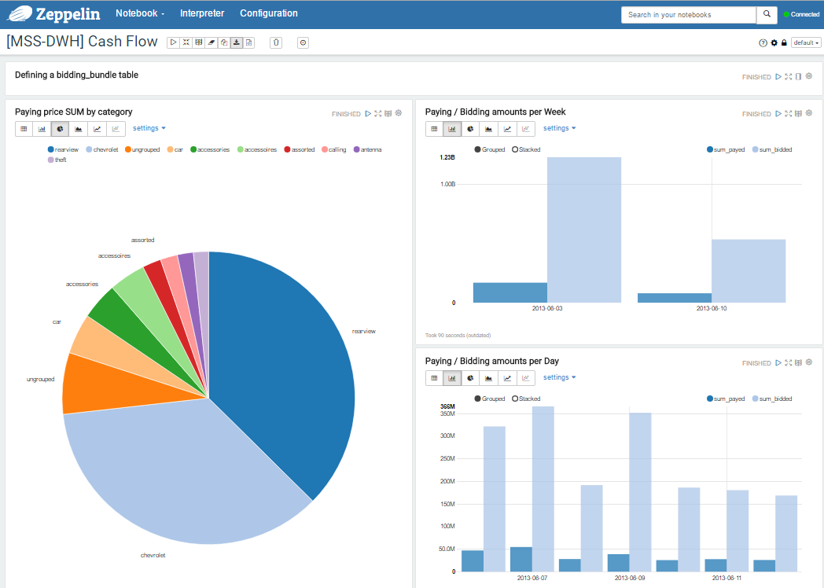
ZEPPELIN
DWH – CASH FLOW

Slide 17
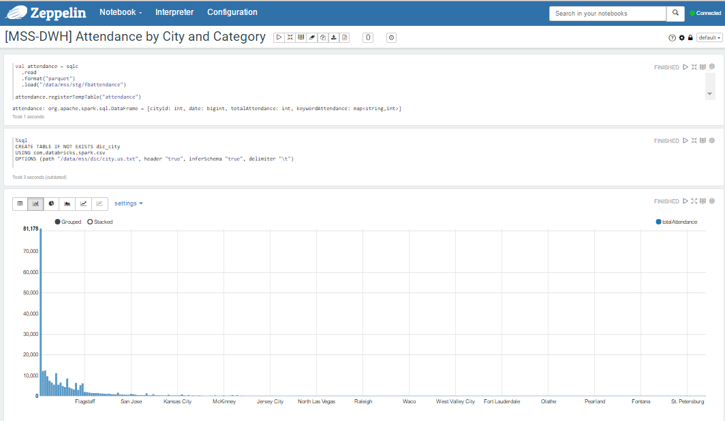
ZEPPELIN
DWH – FACEBOOK DATA

Slide 18
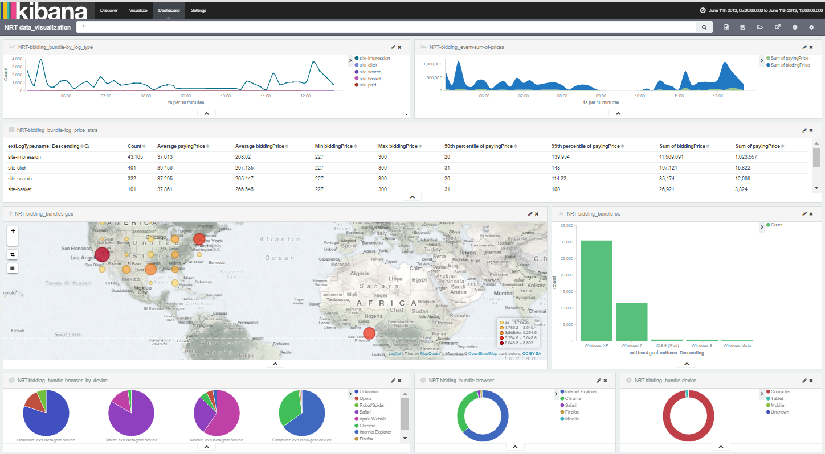
KIBANA
NRT – DATA VIZUALIZATION

Slide 19
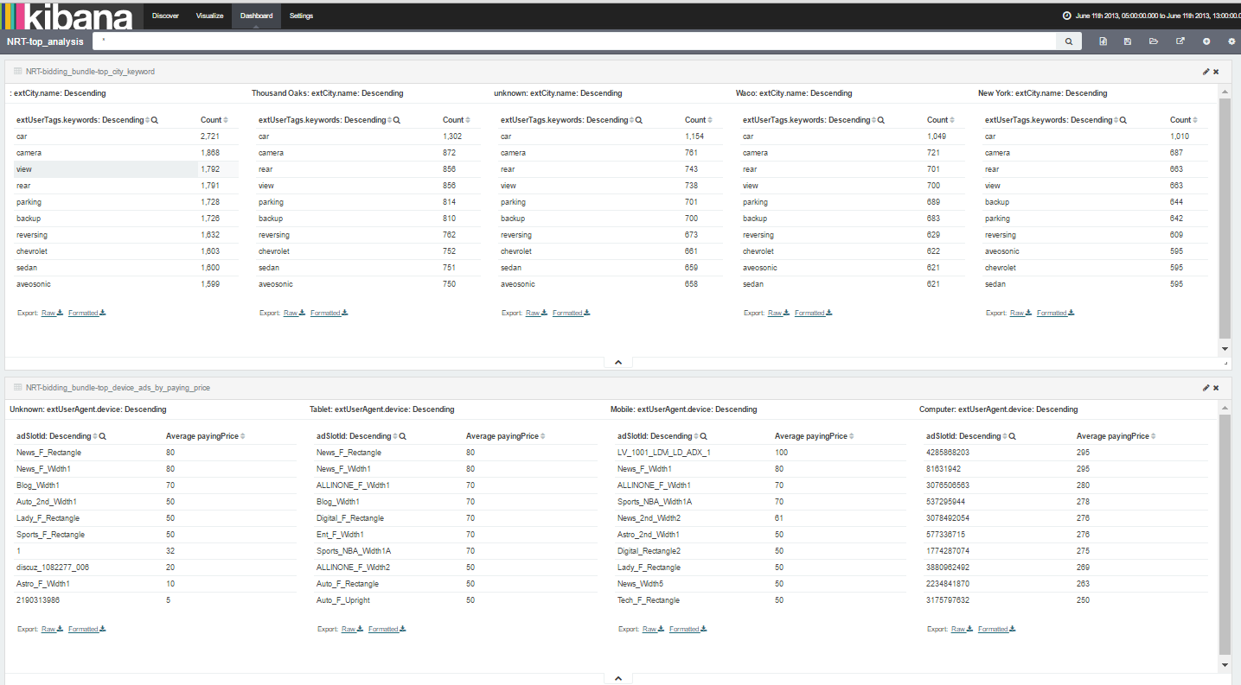
KIBANA
NRT – TOP ANALYSIS

Slide 20
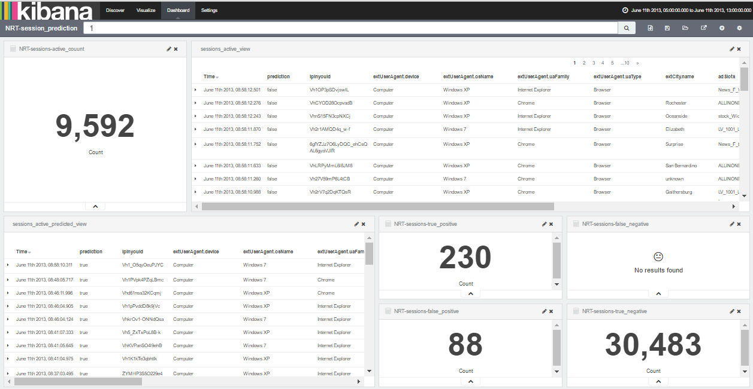
KIBANA
NRT – SESSION PREDICTION

Slide 21
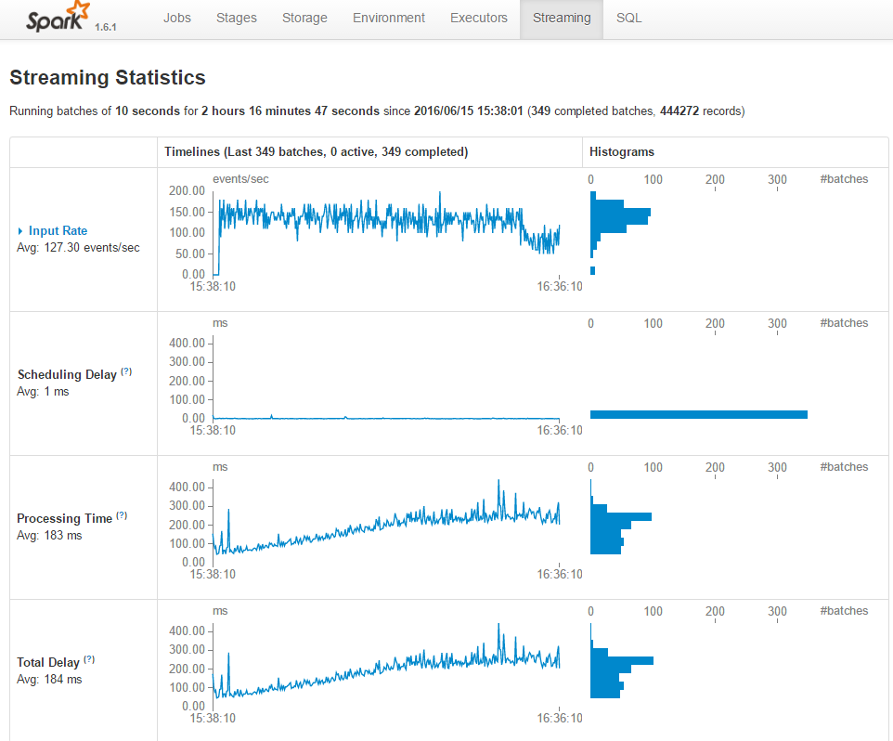
SPARK
SPARK STREAMING UI

Slide 22

Q&A

Slide 23

THE TEAM
BIG DATA RAMP UP TEAM 2
Aleksander Khanteev
Anton Mushin
Daria Stepanova
Evgeny Kincharov
Ivan Zhuravel
Svyatoslav Kovalenko
Vitaliy Zinchenko
https://git.epam.com/ivan_zhuravel/big-data-project
SOURCE CODE

Slide 24
THANK YOU!

